Slide 1
UML Diagrams
in Software Engineering
A complete guide to all 14 UML diagram types
with an Online Food Ordering System as the running example
Unified Modeling Language • Structural & Behavioral Diagrams • Software Engineering

Slide 2
What is UML?
Definition
Why UML?
Unified Modeling Language (UML)
is a standardized visual language for specifying, constructing, visualizing, and documenting software systems. Standardized by: Object Management Group (OMG) Current version: UML 2.5 Purpose: Visualize system architecture, design, and behavior before coding begins.
📐 Blueprint
Serves as the blueprint before writing code
🤝 Communication
Common language between developers, clients, and stakeholders
🐛 Fewer Bugs
Catch design flaws early in the development cycle
📚 Documentation
Auto-generate or maintain system documentation
🔄 Reusability
Identify patterns and reuse designs across projects

Slide 3
UML Diagram Types — Overview
🏛 STRUCTURAL DIAGRAMS (7)
⚙️ BEHAVIORAL DIAGRAMS (7)
1. Class Diagram
1. Use Case Diagram
2. Object Diagram
2. Activity Diagram
3. Component Diagram
3. Sequence Diagram
4. Deployment Diagram
4. State Machine Diagram
5. Package Diagram
5. Communication Diagram
6. Composite Structure Diagram
6. Interaction Overview
7. Profile Diagram
7. Timing Diagram

Slide 4
When to Use Which Diagram?
Class Diagram
Component Diagram
Design the data model and class relationships
Show architecture of software modules
Use Case Diagram
Deployment Diagram
Define system scope and user interactions
Plan infrastructure and server setup
Sequence Diagram
Object Diagram
Model step-by-step workflows and API calls
Validate design with real data examples
Activity Diagram
Communication Diagram
Show business process or algorithm flow
Show object collaboration in a network
State Machine
Timing Diagram
Track lifecycle of an object (Order, Payment)
Show time-based state changes

Slide 5
Running Example
🍕 Online Food Ordering System
All 14 UML diagrams will model this single system
👤
🍳
🛵
🛠️
Customer
Restaurant
Delivery Agent
Admin
Browses menu, places orders, tracks delivery
Receives & prepares food orders
Picks up and delivers orders
Manages users, restaurants, and system

Slide 6
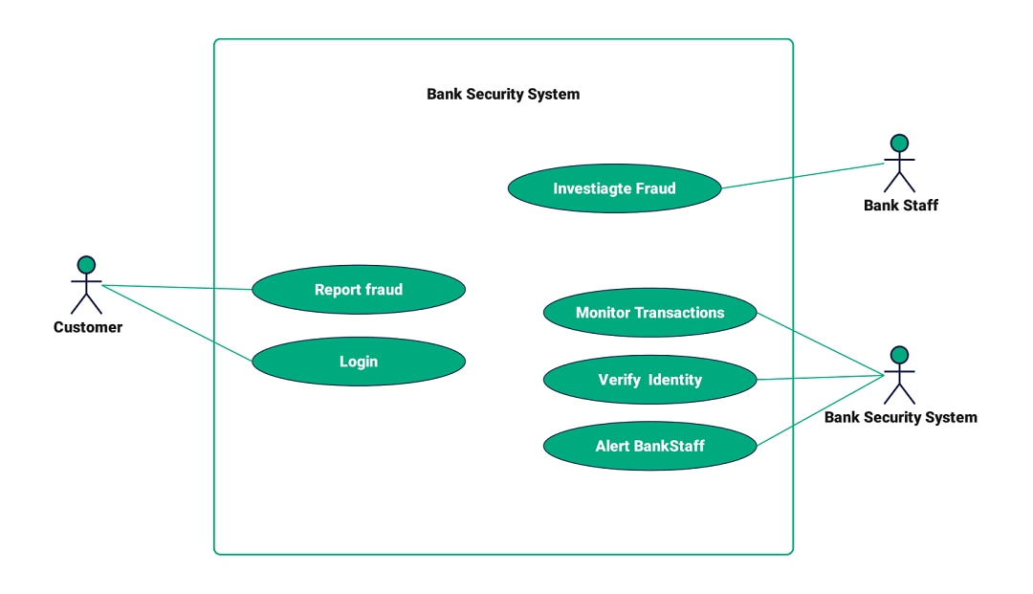
2. Use Case Diagram | Behavioral
Shows actors and their interactions with the system. Captures system functionality from user perspective.
Components
Actor
Stick figure — external user or system
Use Case
Oval — a system function
System Boundary
Rectangle — scope of system
Association
Line — actor uses case
<<include>>
Mandatory sub-function
<<extend>>
Optional extension
Generalization
Arrow — inheritance

Slide 7
2. Use Case Diagram | Behavioral
Shows actors and their interactions with the system. Captures system functionality from user perspective.
Online Food Ordering System
Components
Actor
Browse Menu
Place Order
Stick figure — external user or system
👤
Use Case
🍳
Oval — a system function
Customer
Track Order
Make Payment
Restaurant
System Boundary
Rectangle — scope of system
Association
Line — actor uses case
Write Review
Manage Menu
<<include>>
Mandatory sub-function
<<extend>>
Optional extension
Cancel Order
Generalization
Arrow — inheritance

Slide 8
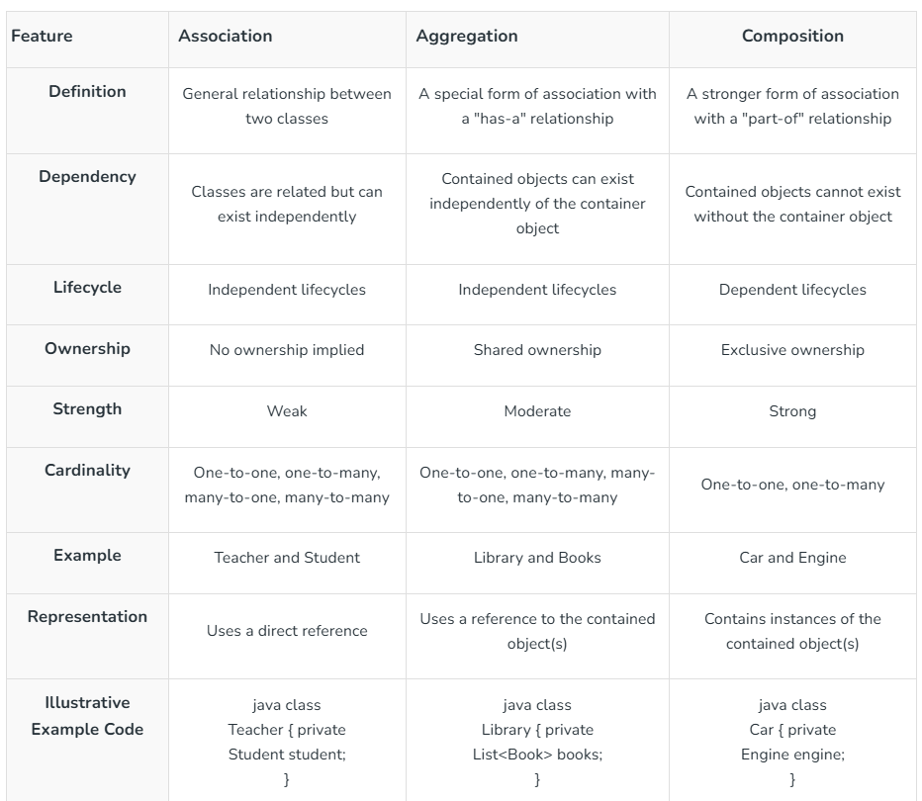

Slide 9
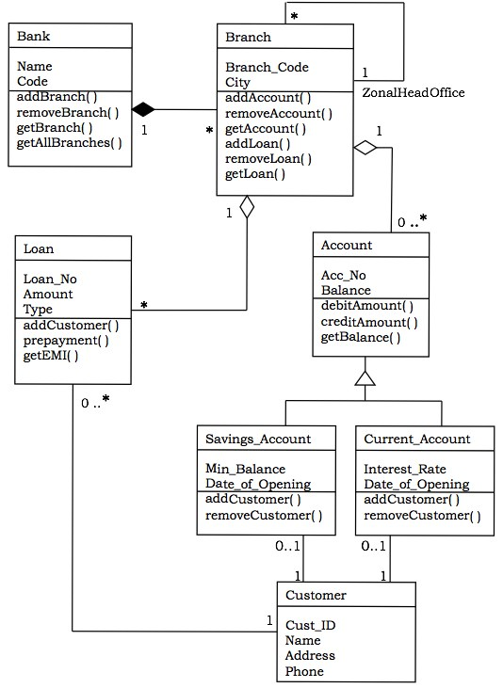
1. Class Diagram | Structural
Shows classes, attributes, methods, and relationships. Most widely used UML diagram.
Components
Class Name:
Top compartment, bold
Attributes:
Middle: name: type
Methods:
Bottom: name(): type
+ Public:
Visible everywhere
- Private:
Only within class
# Protected:
Class & subclasses
Association:
— simple line
Inheritance:
—▷ hollow arrow
Aggregation:
—◇ hollow diamond
Composition:
—◆ filled diamond
+ isAvailable(): bool
+ acceptOrder(): void

Slide 10
1. Class Diagram | Structural
Shows classes, attributes, methods, and relationships. Most widely used UML diagram.
Components
Customer
Order
Class Name:
Top compartment, bold
- customerId: int
- orderId: int
- name: String
- status: String
Attributes:
Middle: name: type
- email: String
- totalAmount: double
Methods:
Bottom: name(): type
- phone: String
- createdAt: Date
+ Public:
Visible everywhere
+ register(): void
+ calculateTotal(): double
+ login(): bool
+ updateStatus(): void
- Private:
Only within class
+ placeOrder(): Order
MenuItem
Restaurant
# Protected:
Class & subclasses
- itemId: int
- restaurantId: int
Association:
— simple line
- name: String
- name: String
Inheritance:
—▷ hollow arrow
- price: double
- rating: float
Aggregation:
—◇ hollow diamond
- category: String
- address: String
Composition:
—◆ filled diamond
+ getPrice(): double
+ getMenu(): List
+ isAvailable(): bool
+ acceptOrder(): void

